Slide 1

Movie Guru
Group no.1
(Ophelia, Jucary, Mohan, Dalton, Ali)
Aug. 2021

Slide 2
Description
Several scenarios and stories discussed such as internet band width in different states , we choose IMDB data source from Kaggle.com to explore :
- number of film in different genre in each country
- allocate the no of movies produce in each country on the map.
- average rating of each genre in different countries.

Slide 3
Flow chart
CSV file
Chose column for analysis
Import data in jupyter notebook
structure the data
Create SQL database
ETL complete
(Cleaning-notebook.ipynd
- create flask and api to call database

Slide 4
Database- ETL

Slide 5
Coding journey

Slide 6
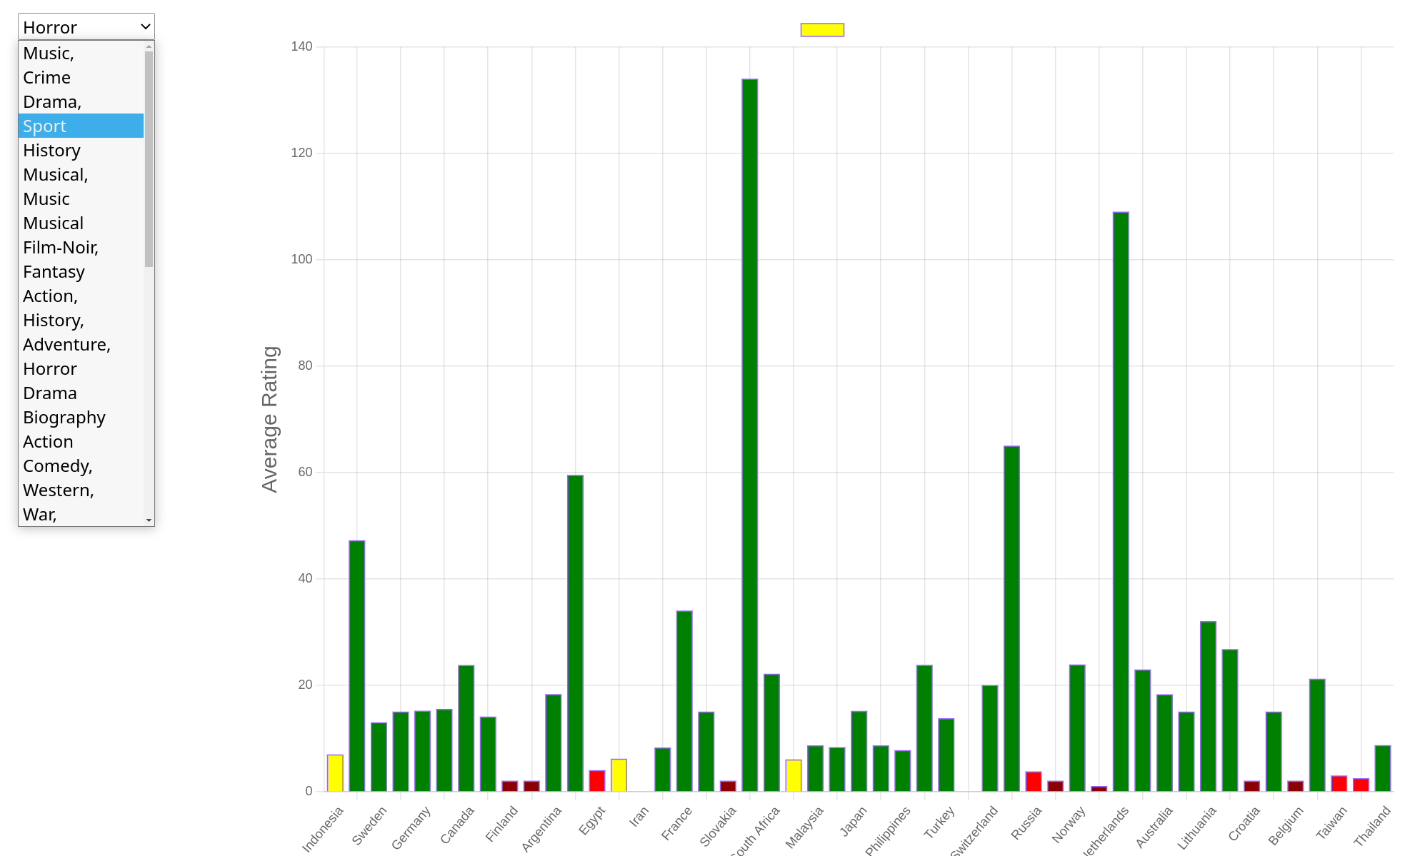
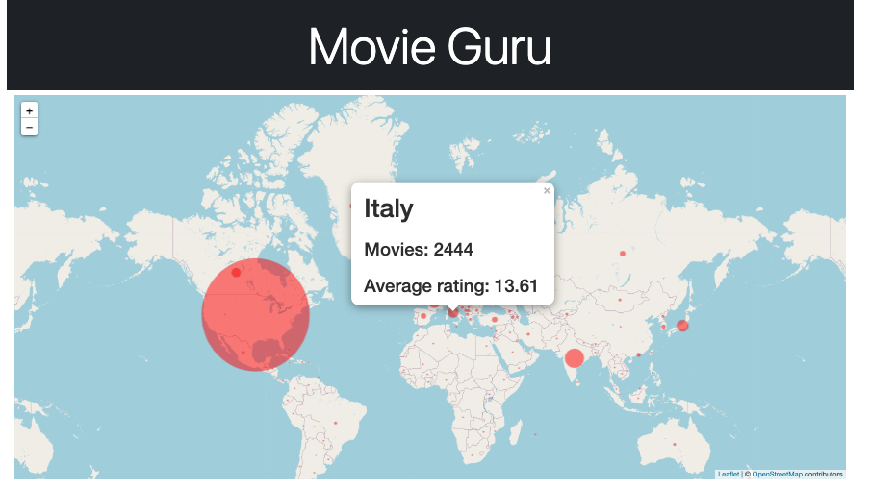
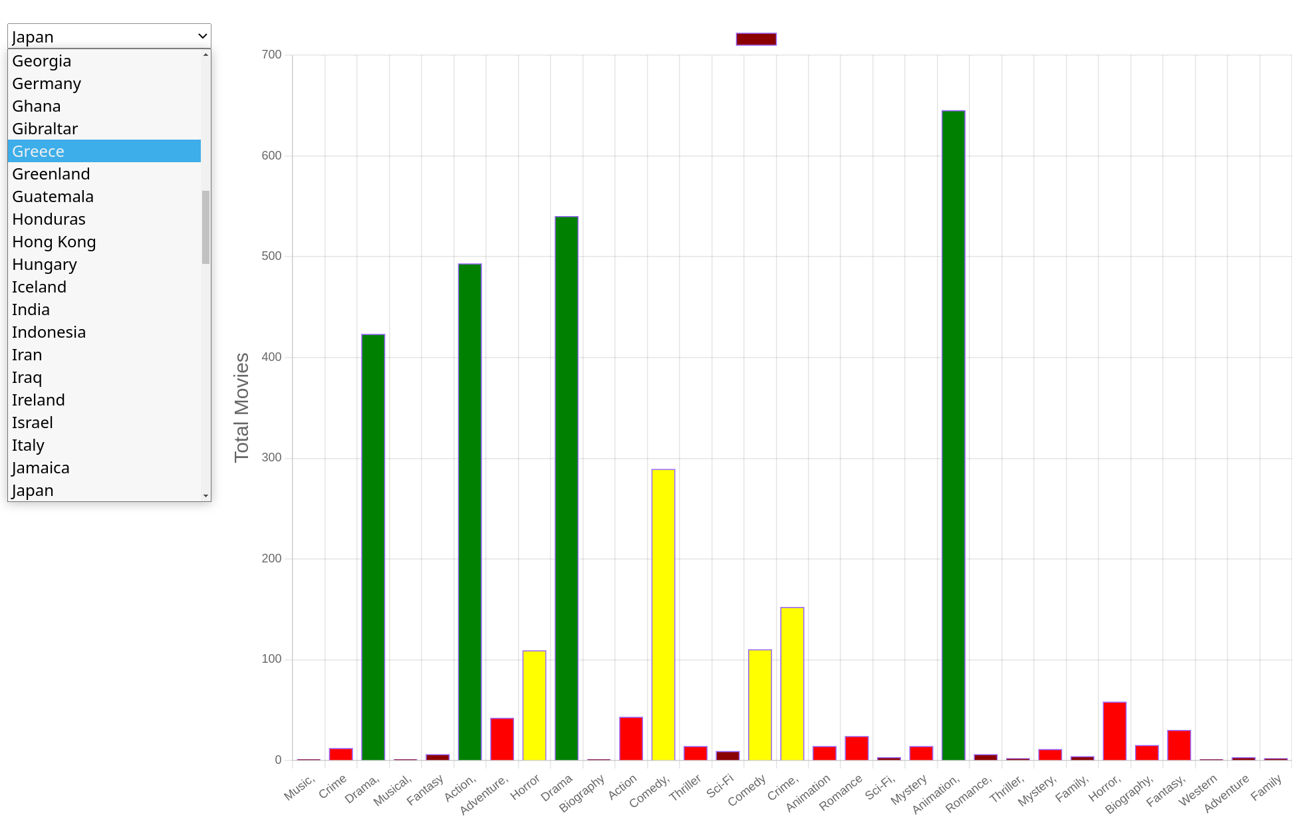
Visualization journey
Average rating for genre selected in dropdown for each country
ChartJS is a new library not covered in the class
Flask api route (“/<genre_name>”) used to query for the data grouped by country
Leaflet Map showing movies produced in each country
USA > India > Japan > France > Italy
Flask api route (“/”) to render data on landing page
Total movies in each genre for country selected in dropdown
Flask api route (“/country/<name>”) used to query for the data grouped by genre

Slide 7
Challenges

